Slide 1
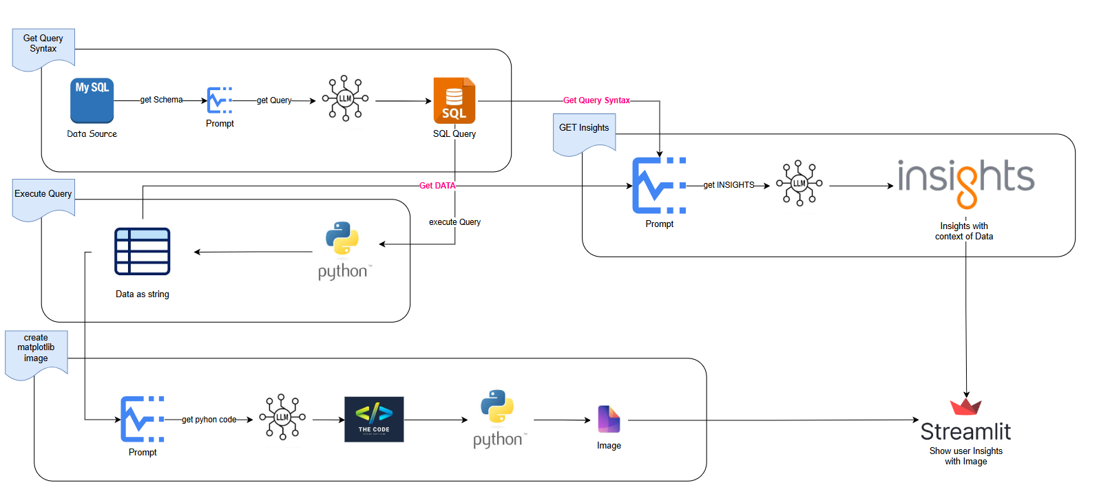
CODE PROCESS REVIEW - CHAT WITH YOUR DATA

Slide 2
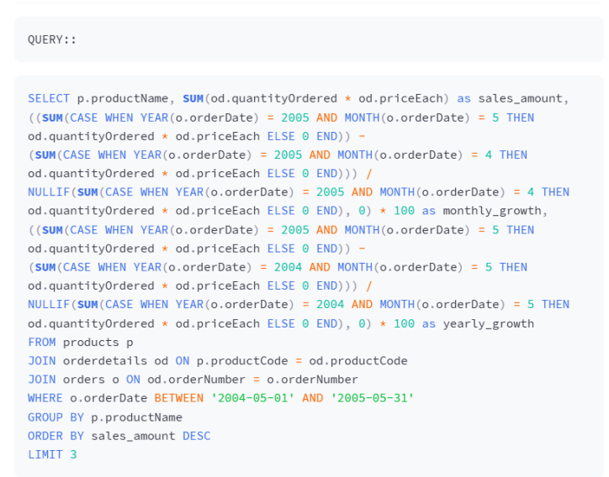
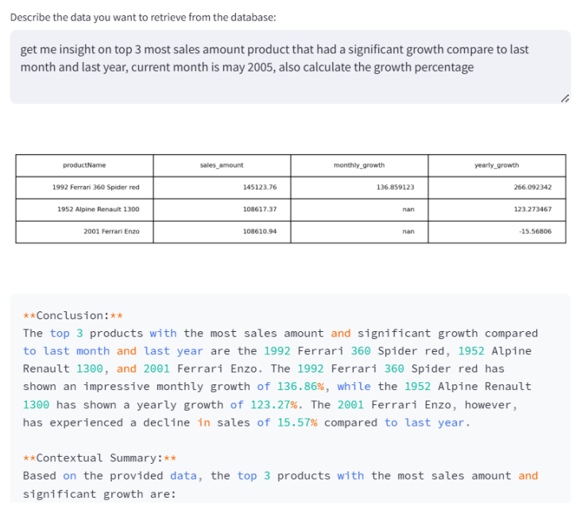

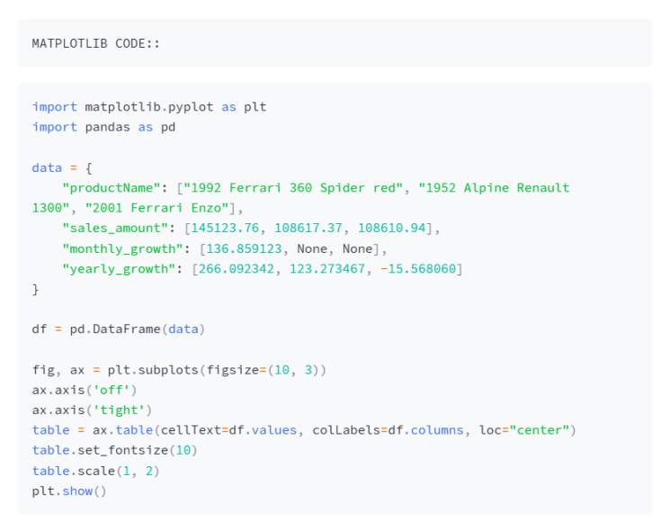
OUTPUT - CHAT WITH YOUR DATA

